Slide 1
Technology integrated with green logistics - a way for reducing environmental impact throughout the supply chain in E- commerce logistics network ?
Ninad Killledar
SID NO: (12775008)

Slide 2
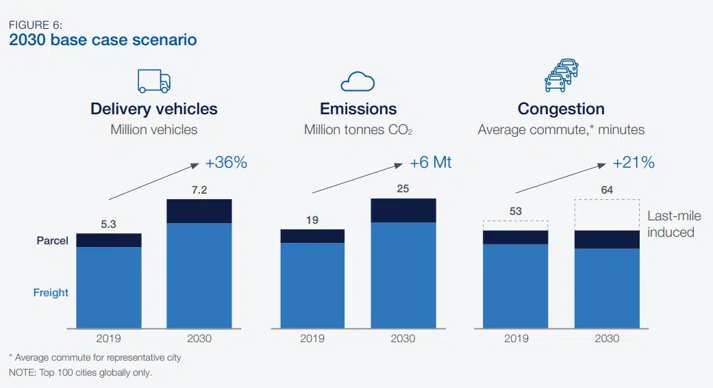
E- commerce logistics and its environmental impact
E-commerce has already seen, reshaping the global retail industry, and online shopping is one of the most popular, made even more so by the COVID-19 pandemic. The e- commerce sector is causing changes in business strategies and concepts in order to entice consumers, such as same-day home or few-hour deliveries, which is creating further environmental damage. (Rao et al., 2021)
According to World Economic Forum, the increased demand for urban last-mile delivery of online purchases has resulted in 36% more delivery vehicles in 100 cities worldwide, creating environmental-related emissions to increase by approximately one-third. (World Economic Forum, 2020)
According to Forbes Report 2019, environmental footprint of online shopping is greater than physical stores because of the increasing number of items being redelivered or returned (Forbes, 2019), hence leading to vehicle routing problems (VRP) in reverse logistics eventually increasing emissions from several freight transportation vehicles. (Besbes et al., 2020)
Source: (World Economic Forum, 2020)

Slide 3
According to CNN Business due to high packaging waste and the fact that ecommerce products typically originate from multiple distribution centers, ecommerce can be more detrimental to the environment than driving to a brick and-mortar retail store. Further to that, in 81% of shopping gatherings in the Great Britain, the overall greenhouse gas footprints per item purchased from brick - and - mortar were relatively low than those generated by e- commerce shopping. (CNN Business, 2020)
Commodities packaging adds substantially to CO2 emissions from plastic production, contaminating ecosystems, and incorporating massive volumes of waste to the landfills. According to Canopy, a forest conservation organization, 3 billion trees are pulped each year to produce 241 million tonnes of shipping cartons. (Canopy, 2022). Every year, only just China's courier industry generates approximately 1.8 million tonnes of plastic waste and over 9 million tonnes of paper waste according to State Post Bureau. (Chen , 2021)
Another environmental impact of ecommerce shopping is shipping emissions. In 2020, product shipping and return estimated to account for 37% of overall green house gas emissions. The number of delivery vehicles is expected to increase by 36% by 2030, causing a rise of approximately 6 million tonnes of CO2 emissions as vehicles take longer to commute due to increased traffic congestion. (Igini, 2022)
Furthermore, is the concept of cross-border e-commerce enterprises which need cross-border logistics to realize transnational transportation and trading. And as cross-border logistics being more complex it needs right cross-border logistics mode that can help cross-border e-commerce enterprises achieve long-term sustainable development. (Li et al., 2023)
Lastly, reverse logistics which is concerned with managing the movement of goods back to manufacturers, distributors, and retailers. And due to growth of returns resulting from the rise of e-commerce reverse logistics is becoming even more challenging thus leading to excess carbon emissions. (Siegfried et al., 2021)
The e-commerce has caused challenges of increased freight volumes, reduced lot sizes and an increased number of delivery points which can be overcome by a transport technologies such as, electrified last-mile urban distribution through EV's, dynamic vehicle routing and path optimization. (Schöder et al., 2016)

Slide 4
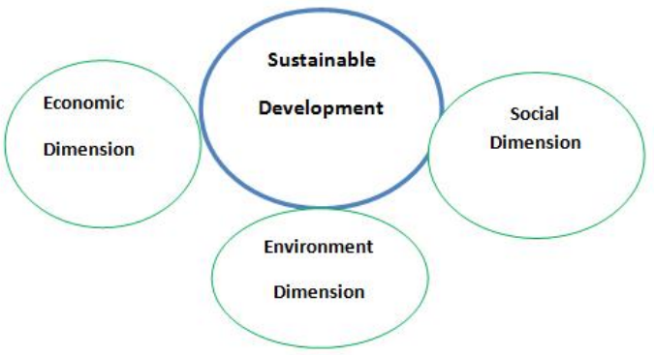
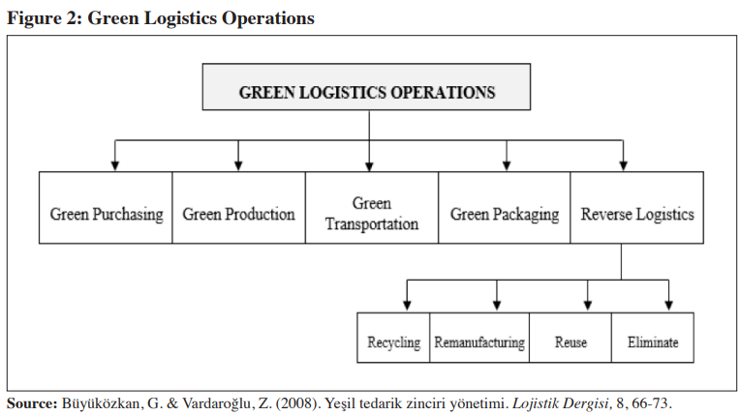
Introduction to concept of Green logistics
Green logistics (or sustainable logistics) is concerned with minimizing the environmental as well as other adverse effects of supply movement. Green supply chains strive to minimize detrimental effect by redesigning distribution networks, sourcing, and reverse logistics to eliminate inefficiencies, unneeded transportation movement patterns, and packaging dumping. (Vidová et al., 2012)
Interrelation of Green logistics and sustainability :
Green logistics is a manifold discipline with the main objective of efficiently coordinating all operations while balancing economic, environmental, and social responsibilities. Green logistics principles incorporate environmental considerations into logistics operations with the goal to advance society's sustainability. (El-Berishy et al., 2013)
Source: (Kumar, 2015)
Source: (GÜLMEZ & TÜZÜN RAD, 2017)
Notes:
The primary objective of green logistics is to integrate all operations in the most effective way possible while balancing economic, environmental, and social priorities. (El-Berishy et al., 2013)
Economic Dimension : To achieve economic sustainability, logistics businesses must promote the growth of innovative and efficient logistics services. Economic dimension is regarded as a fundamental requirement for survival in today's highly competitive environmental global world. Furthermore, economic challenges are intertwined with environmental and social issues. A society that lacks economic stability will be unable to focus on environmental or social issues in addition to economic ones. (El-Berishy et al., 2013) . Green logistics contributes towards creating economic value in various ways such as- improved customer satisfaction, reduced taxes with improved financial performance, good relations with stakeholders and reduced business risk. (Kumar, 2015)
Social Dimension- Social sustainability can be described as growth that fulfills current needs without jeopardizing future generations' capacity to fulfill their own. Sustainable development is a critical objective that signifies a concern for intergenerational social equity. These objectives are eager to minimize the adverse impacts on society, which would include individual citizens, businesses, and government. The concept of social equity assures that all people in the community have equivalent opportunity and access to resources. (El-Berishy et al., 2013) . Green logistics contributes towards creating social value in various ways such as-
reducing social cost, enhanced corporate image , better utilization of natural resources and creation of job opportunities. (Kumar, 2015)
Environment Dimension: The environmental dimension involves an array of goals, planning processes, and frameworks that promote increased environmental responsibility and the advancement and diffusion of environmentally conscious technologies, as well as numerous sustainability research efforts has been fixated on this dimension. (El-Berishy et al., 2013) Green logistics promotes environmental consciousness by encouraging all users of the logistics network to consider how their actions impact the environment. (Kumar, 2015)
The framework for green logistics comprises of green transport; green warehousing; green packaging; green logistics data collection and management; waste management along with employing advanced technology to minimize further damage to economic, social and environmental dimensions. (Kumar, 2015)

Slide 5
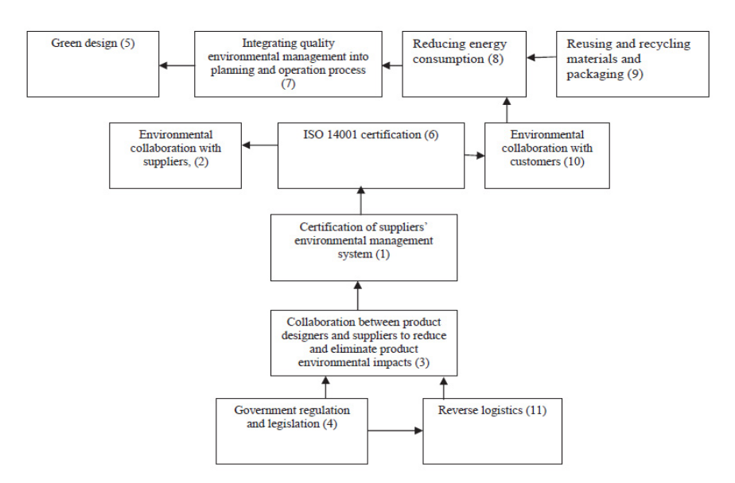
Need for green logistic in E- commerce:
To integrate environmental concerns into supply chain operations and simultaneously adapt to rising customer demands, environmental concerns couldn't be addressed separately at every stage of the chain. As a result, developing and implementing integrated strategies for logistics operations within the larger framework of sustainable growth is desired. And green logistics is precisely the considered necessary model. (El-Berishy et al., 2013)
It attest to a company's adherence to environmental regulations. (Kuruvilla et al., 2020)
Reduce air, soil, water, and noise pollution by examining the impact within each logistics area, particularly those connected to transportation. (Kuruvilla et al., 2020)
Make the most of ones supplies by recycling packaging and reusing containers. (Kuruvilla et al., 2020)
Calculate the carbon output of logistical operations as a starting point for evaluating sustainable strategies and attempting to control their outcomes. The UNE-EN 16258:2013 international standard is one of the most widely used approaches for estimating energy usage and GHG emission levels. (Kuruvilla et al., 2020)
Drivers affecting implementation of Green Logistics in E-commerce
Source:
(Seroka-Stolka, 2014)
Notes:
The main drivers of green logistics : (Dhull & Narwal, 2016)
Government regulation and legislation : The central governmental environmental policies which influence businesses to go green are thought to be the main driver of sustainability practices. Legislative compliance regulations compel companies to implement green SCM and logistics frameworks.
Improve firm performance and reduce cost : Green practices that enhance organizational performance seem to be more frequently and conveniently adopted by businesses. Businesses also are willing to shift to eco friendly materials in order to lower the cost of their commodities.
Employee involvement : Staff member's environmental consciousness and knowledge serve as a motivator for the adoption of green practices.
Cost of hazardous waste disposal : The hazardous items should be disposed of in accordance with environmental guidelines. The expense of disposing of hazardous components is considerably significant. Hence, company may enforce green logistics to cut costs.
ISO 14001 certification : Most businesses are pursuing ISO 14001 certification, and in order to obtain this certification, they must implement an environmental management programme.
Customer demand and awareness : In the twenty-first century, there is a growing customer demand for environmentally sustainable goods. Customer's awareness in environmentally sustainable goods compels suppliers to develop products that are sustainable.
Competitive advantage : This is a strategy to improve a company's environmental efficiency in order to gain a competitive advantage over its competitors and emerge as one of the driving forces of green strategies.
Pressure by environment advocacy groups : Specific environmental groups may put pressure on businesses to combat specific environmental pollution in order to keep industries aware and the environment clean.
Collaboration with suppliers: diverse group of suppliers have reached an agreement to implement green sustainable initiatives. Also, if suppliers encourage sustainable goods, then business groups must comply in order to remain in business. Furthermore, to keep suppliers in business, industry representatives sign agreements to go sustainable with one another.

Slide 6
Industry 4.0 technology integrated green logistics framework for E- commerce sector
Industry 4.0 applications have included the most advanced technologies, especially in the nanotechnology, telecommunications, internet fields, such as digital twinning, IoT, RFID, and so on, that have enabled us to use small devices more productively. This integration of digitalization enables the development of numerous applications that has revolutionized the world of logistics. Utilizing industry 4.0 technological advances assists in achieving various applications in the green logistics area that achieve long-term savings in terms of time, material, and energy. For example: (Bányai & Zaher Akkad, 2021)
Smart Containers
Route Optimization of collection and transfer trucks
Data Management
Local Composting
Furthermore, another sustainable strategies related to green logistics include following approaches : . (Kuruvilla et al., 2020)
Eco-friendly purchasing and procurement policies.
Optimizing transport fleet management.
Warehouse adopting sustainable construction and management standards.
Enabling measures to reduce and recycle waste produced in warehouse.
Improving stock management and reverse logistics.
Notes:
Smart Containers – It is a innovation based on IoT (Internet of Things) technology which uses sensors that are linked together to gather, organize, and transfer the container’s data and provide real-time data anywhere across the world. The most important problem that the smart containers solve is the transparency in logistics of a supply chain by geofencing, monitoring delays, providing geolocation and radio frequency identification (RFID) technology. (Bányai & Zaher Akkad, 2021)
Route Optimization – This technology uses optimization algorithms to create the shortest route for last mile delivery along with stop sequences in order to avoid traffic congestion in urban cities. Along with this it also optimizes capacity of delivery fleet to ensure efficient utilization of the entire capacity. It also facilitates better forecasting of estimated travel allowing flexibility to handle critical shipment orders. (Bányai & Zaher Akkad, 2021)
Data Management- All components of cyber-physical processes should be directly connected to data management via the internet. This management stores data and interacts directly with all system components. This management saves data on algorithms used to create shipping routes, delivery schedule, collection trucks, and volumes in each part of the system. (Bányai & Zaher Akkad, 2021)
Local Composting - Local composting would be linked to data management, displaying the remaining space for waste until it's completely full as well as the time period required to complete the transition into compost. It would also inform the user about the amount and timing of compost gathering. (Bányai & Zaher Akkad, 2021)
Eco-friendly purchasing and procurement policies - Purchasing packaging that is sustainable and limiting the use of plastic in packaging.
Optimizing transport fleet management – it includes last mile route optimization and prioritize load pooling along with facilitating use of alternative fuels such as CNG, hybrid, electric, battery-operated vehicles and equipments to improve fuel efficiency and driving methods leading to more economical and sustainable transportation.
Using Warehouse management systems (WMS) technology and sustainable packaging to improve operations and reduce waste alongside building Logistics 4.0 buildings which are LEED- certified green building instead using traditional concrete in order to optimize energy consumption. It will ensure technology integrated both green warehousing and green packaging.
Improving stock management and reverse logistics - Reducing movement within the fulfilment centre by combining precise storage location management with streamlined picking strategies. Preventing stock damage from manual handling processes and instead implementing automated processes and robots in warehouses to solve this problem.

Slide 7
Examples of major E-commerce industries adopting green logistics
1) NIKE (Nike impact report, 2021)
2) DHL (DHL ESG report, 2021)
3) WALMART (Walmart ESG report, 2022)
4) ALDI (Aldi, 2022)
5) AMAZON (Amazon sustainability report, 2021)
6) COTY (Coty sustainability report, 2022)
7) ALIBABA GROUP (Alibaba carbon neutrality action report, 2021)
8) MAERSK (Maersk sustainability report, 2022)
9) OCADO GROUP (Ocado group,2022)
Notes:
There are some major e-commerce companies which have started to adopt the green logistics practices. These companies have integrated their company’s vision and purpose along side a commitment to reduce environmental impact and make their operations and facilities sustainable in a longer run. Hence, ultimately contributing towards the 17 Sustainable Development Goals (SDG’s) formed by United Nations.
Nike – According to Nike’s Impact Report 2021, Greenhouse gas emissions in owned or operated facilities are reduced by 70% in absolute terms by using 100% renewable electricity and electrifying fleets. In Mexico as well as in Belgium, Nike has installed rooftop solar array over its distribution center to cover the significant electricity needs. Also, they are launching smart buildings pilots and expanding employee EV (electric vehicle) charging network. Nike has expanded its testing of alternative fuels for both ocean and air freight. These pilots utilized waste-derived bio – fuels and hydro-treated vegetable oil (HVO) solutions, resulting in a decrease of nearly 11,000 metric tonnes of carbon emissions. Nike has also begun to utilize electric trucks for deliveries in Seoul, Mexico and Tokyo. Also, in Greater China it has used alternative transportation methods by using new railways systems which reduced carbon emissions in outbound freight by approximately 572 metric tons. Nike has optimized its packaging processes by making use of green and digital packaging and eliminating single-use plastic packaging. (Nike impact report, 2021)
DHL - According to DHL’s ESG Report 2021, it has invested nearly 28 million, 115 million and 13 million for purchasing sustainable fuels, fleet electrification, and carbon-building neutral technology, respectively. For sustainable air freight DHL is replacing aircraft with deployment of e-planes. Urban last mile delivery play a crucial part in e-commerce and has a major impact on environment. DHL has electrified and further aims to electrify 60% of last mile delivery vehicles. Also, it continuously optimizes its network to reduce fuel consumption and drives innovation through hydrogen trucks. Furthermore, DHL uses concept of building automation to make use of smart building management systems along with procuring of electricity from renewable resources to make the buildings climate neutral. (Nike ESG report, 2021)
Walmart - According to Walmart’s ESG Report 2021, it is achieving zero operational waste in Canada, Mexico and U.S. by recycling rigid plastics and reusable packaging containers along with reducing food waste in value chain to contribute towards circular economy. Walmart practices sustainable sourcing by sourcing commodities in accordance with certifications that support nature-related goals.
Aldi - Aldi uses concept of green electricity which is generated by renewable resources. Aldi’s UK stores and regional distribution centres combined has over 100,000 solar panels for systematic reduction in energy consumption. Aldi is optimizing fuel consumption and utilizing double deck trailers to reduce number of trips and eventually decrease carbon emissions. Aldi is eliminating waste throughout supply chain by 100% recyclable packaging and nearly halving the plastic footprint.
Amazon - , Amazon has adopted to constructing green buildings by investing in CarbonCure Technologies, which enables to make the same high-quality concrete with a lower carbon footprint, as the carbon neutral cement passively absorbs CO2. Amazon has started expanding to 100,000 electric delivery fleet vehicles and is deploying them across Europe, Latin America, Asia and Middle East to reduce emissions on last-mile routes to the customers doorsteps. Amazon has switched to alternative fuel using vehicles such as compressed natural gas (CNG) trucks that are significantly reducing carbon emissions.
Coty - - According to Coty’s Sustainability Report 2022, it has optimized its manufacturing processes uses carbon-captured ethanol in production of its fragrences along with responsible sourcing and to improve traceability and transparency to build a sustainable supply chain.
Alibaba group – Alibaba group has established its first collaborative electric motorcycle fleet to reduce last mile delivery carbon footprint .They are exploring the development of smart transportation systems with autonomous vehicles and combination of artificial intelligence (AI) and electrification which can improve transportation efficiency. Furthermore, Cloud Computing is the Digital Infrastructure for the Low-carbon Circular Economy which is undertaken by Alibaba group.
Maersk – Maersk make uses of alternative green fuels such as biodiesel, green methanol and green ammonia for green logistical solutions for sea, aviation as well as road freight. Maersk has constructed every logistical building in UK, Brazil and Denmark using green building concept. Furthermore, it has electrified last mile delivery by electric trucks in U.S.
Ocado Group – Ocado is the first e-commerce supermarket to accomplished zero food waste across its value chain by strategic inventory planning and digitalization. Ocado has started constructing their own natural gas station to fuel their LGV’s and also, they have invested in 17 electric fleet vehicles to reduce the overall carbon impact.

Slide 8
Barriers in implementing green logistics framework in developing countries
Barriers to adopting green logistics
Lack of commitment from top management
Financial Constraints
Organizational culture inhibitive to sustainability
Lack of new advance technology
Lack of performance evaluation standards on sustainability
Lack of awareness/benefits on sustainability
Lack of green purchasing
Lack of regulations and enforcement of environmental standards
Lack of R&D on sustainability
Resistance to change and adopting innovation in sustainability
Lack of training/human expertise on sustainability
Source: (Dashore & Sohani, 2013)
Notes:
Barriers to adopting green logistics framework in developing countries : (Dhull & Narwal, 2016)
Lack of commitment from top management - there is no primary concern or adequate allocation of resources for sustainability considerations in the absence of top management's commitment. There's no vision for shaping policy and achieving sustainability targets.
Organizational culture inhibitive to sustainability - Organizational values and culture that prioritize both environmental and social components.
Financial constraints – it discourages high capital investments, loan assistance, and a reduces investment return for sustainability practices.
Lack of awareness of benefits of sustainability - lack of understanding about environmentally hazardous materials and the advantages of adopting sustainability programmes.
Lack of new advance technology - emerging technological advancements, components, and strategies are being created to minimize waste, improve efficiency, strengthen safety systems, and decrease pollution levels.
Lack of R&D on sustainability - There is an absence of research and development on recycling technologies, product reusability and recyclability, and lessening polluting techniques. Research and development aids in the reduction of natural resource and energy consumption as well as the integration of technological innovations with sustainable development.
Lack of green purchasing - in the purchase of input materials, there is insufficient consideration and weightage allocated to sustainability principles.
Lack of training/human expertise on sustainability - There is a scarcity of experienced professionals and specialists in different aspects of sustainable supply chain management (SSSCM). Skills and professionalism are required to lead and enforce the aspects of sustainability.
Lack of regulations and enforcement of environment standards - The implementation of sustainable policies is not backed by strong laws or government assistance.
Lack of performance evaluation standards on sustainability - Sustainability initiatives are difficult to quantify and assess. The approaches used to authenticate sustainability performance are not consistent.
Resistance to change and adopting innovation in sustainability - Employees are generally resistant to departing from traditional methods and embracing innovation. There is apprehension about failing and resistance to necessary reforms.

Slide 9
Conclusion
The constant growth of e-commerce transactions and the parcel distribution in cities increases the entry of trucks and cargo vehicles in cities. As a result, last-mile logistics is generating negative externalities related to the increase in consumption, congestion, waste, emissions, and pollutions impacting the economic, social and environmental dimensions of sustainability. (Viu-Roig & Alvarez-Palau, 2020) . Hence Green Logistics is the sustainable strategy which covers every aspect from green procurement, green packaging, green transportation, green fuels, green warehousing, green buildings to reduce the impact on environment. A trend of technology and digitalization has been seen post-Covid and as a matter of fact, companies have started integrating technology into their sustainable practices to mitigate emissions. But due to lack of awareness, government regulations and proper infrastructure along with numerous other barriers developing countries are still struggling to adopt the concept of green logistics.
Notes:
Barriers to adopting green logistics framework in developing countries : (Dhull & Narwal, 2016)
Lack of commitment from top management - there is no primary concern or adequate allocation of resources for sustainability considerations in the absence of top management's commitment. There's no vision for shaping policy and achieving sustainability targets.
Organizational culture inhibitive to sustainability - Organizational values and culture that prioritize both environmental and social components.
Financial constraints – it discourages high capital investments, loan assistance, and a reduces investment return for sustainability practices.
Lack of awareness of benefits of sustainability - lack of understanding about environmentally hazardous materials and the advantages of adopting sustainability programmes.
Lack of new advance technology - emerging technological advancements, components, and strategies are being created to minimize waste, improve efficiency, strengthen safety systems, and decrease pollution levels.
Lack of R&D on sustainability - There is an absence of research and development on recycling technologies, product reusability and recyclability, and lessening polluting techniques. Research and development aids in the reduction of natural resource and energy consumption as well as the integration of technological innovations with sustainable development.
Lack of green purchasing - in the purchase of input materials, there is insufficient consideration and weightage allocated to sustainability principles.
Lack of training/human expertise on sustainability - There is a scarcity of experienced professionals and specialists in different aspects of sustainable supply chain management (SSSCM). Skills and professionalism are required to lead and enforce the aspects of sustainability.
Lack of regulations and enforcement of environment standards - The implementation of sustainable policies is not backed by strong laws or government assistance.
Lack of performance evaluation standards on sustainability - Sustainability initiatives are difficult to quantify and assess. The approaches used to authenticate sustainability performance are not consistent.
Resistance to change and adopting innovation in sustainability - Employees are generally resistant to departing from traditional methods and embracing innovation. There is apprehension about failing and resistance to necessary reforms.

Slide 10
References
Aldi UK and Ireland have been carbon neutral since January 2019. Our Environment - Carbon Neutrality - ALDI UK. (n.d.). Retrieved February 18, 2023, from https://www.aldi.co.uk/about-aldi/corporate-responsibility/environment/carbon-neutrality
2021 Alibaba Group Carbon Neutrality Action Report. (2021). Retrieved February 19, 2023, from https://sustainability.alibabagroup.com/en
Bányai, T., & Zaher Akkad, M. (2021). The impact of Industry 4.0 on the future of Green Supply Chain. Green Supply Chain - Competitiveness and Sustainability. https://doi.org/10.5772/intechopen.98366
Besbes, W., Dhouib, D., Wassan, N., & Marrekchi, E. (2020). Green Reverse Logistics: Case of the Vehicle Routing Problem with Delivery and Collection Demands. In Solving transport problems: Towards Green Logistics (pp. 161–184). essay, John Wiley & Sons, Incorporated.
Chen , J. (2021, March 6). China guides e-commerce sector to Greener Path of Development. China guides e-commerce sector to greener path of development - People's Daily Online. Retrieved February 15, 2023, from http://en.people.cn/n3/2021/0306/c90000-9825820.html
Dashore , K., & Sohani, D. N. (2013). Green Supply Chain Management - Barriers & Drivers: A Review. International Journal of Engineering Research & Technology (IJERT), 2(4), 2021–2030.
Dhull, S., & Narwal, M. S. (2016). Drivers and barriers in green supply chain management adaptation: A state-of-art review. Uncertain Supply Chain Management, 61–76. https://doi.org/10.5267/j.uscm.2015.7.003
El-Berishy, N., Rügge, I., & Scholz-Reiter, B. (2013). The interrelation between sustainability and Green Logistics. IFAC Proceedings Volumes, 46(24), 527–531. https://doi.org/10.3182/20130911-3-br-3021.00067
Farmbrough, H. (2019, October 14). Why internet shopping isn't always better for the environment. Forbes. Retrieved February 15, 2023, from https://www.forbes.com/sites/heatherfarmbrough/2019/10/14/why-internet-shopping-isnt-always-better-for-the-environment/?sh=8c5bf9f5c189
FY21 NIKE, Inc. Impact Report . About.nike.com. (2022, March 3). Retrieved February 18, 2023, from https://about.nike.com/en/newsroom/reports/fy21-nike-inc-impact-report-2
GÜLMEZ, Y. S., & TÜZÜN RAD, S. (2017). Green Logistics for Sustainability. International Journal of Management Economics and Business, 13(3), 603–614. https://doi.org/10.17130/ijmeb.2017331327

Slide 11
Homepage. Ocad0 Waste. (2022, August 8). Retrieved February 19, 2023, from https://sustainability.ocadoretail.com/
Igini, M. (2022, December 15). The environmental impact of online shopping. Earth.Org. Retrieved February 15, 2023, from https://earth.org/online-shopping-and-its-environmental-impact/
Kavilanz, P. (2020, July 7). Online shopping can be worse for the environment than driving to a store | CNN business. CNN. Retrieved February 15, 2023, from https://edition.cnn.com/2020/02/26/tech/greenhouse-gas-emissions-retail/index.html
Kumar, A. (2015). Green Logistics for sustainable development: an analytical review. International Journal of Business, 1(1), 7–13.
Kuruvilla, N. M., Saju, R., Chandramana, S. B., & Ramesh, S. (2020). Driving towards Sustainable Development through Green Logistics. Atma Nirbhar Bharat: A Roadmap to Self-Reliant India. https://doi.org/10.6084/m9.figshare.13332302.v2
Li, Z., Gao, G., Xiao, X., & Zuo, H. (2023). Factors and formation path of cross-border e-commerce logistics mode selection. Sustainability, 15(4), 3685. https://doi.org/10.3390/su15043685
Rao, P., Balasubramanian, S., Vihari, N., Jabeen, S., Shukla, V., & Chanchaichujit, J. (2021). The e-commerce supply chain and Environmental Sustainability: An empirical investigation on the online retail sector. Cogent Business & Management, 8(1), 1–29. https://doi.org/10.1080/23311975.2021.1938377
Schöder, D., Ding, F., & Campos, J. K. (2016). The impact of e-commerce development on Urban Logistics Sustainability. Open Journal of Social Sciences, 4(3), 1–6. https://doi.org/10.4236/jss.2016.43001
Seroka-Stolka, O. (2014). The development of Green Logistics for Implementation Sustainable Development Strategy in companies. Procedia - Social and Behavioral Sciences, 151, 302–309. https://doi.org/10.1016/j.sbspro.2014.10.028
Siegfried, P., Michel, A., Tänzler, J., & Jiyuan Zhang, J. (2021). Analyzing sustainability issues in urban logistics in the context of growth of e-commerce. Journal of Social Sciences, IV(1), 6–11. https://doi.org/10.52326/jss.utm.2021.4(1).01
Sustainability at Maersk. Maersk . (2022). Retrieved February 17, 2023, from https://www.maersk.com/Sustainability

Slide 12
Sustainability reports. DHL. (2022, March 9). Retrieved February 18, 2023, from https://www.dpdhl.com/en/sustainability/our-approach/sustainability-reports.html
Vidová, H., Babčanová, D., Witkowski, K., & Saniuk, S. (2012). Logistics and its environmental impacts. The 7th International Scientific Conference "Business and Management 2012". https://doi.org/10.3846/bm.2012.129
Viu-Roig, M., & Alvarez-Palau, E. J. (2020). The impact of e-commerce-related last-mile logistics on cities: A systematic literature review. Sustainability, 12(16), 1–19. https://doi.org/10.3390/su12166492
Walmart Environmental, Social & Governance Reporting. 2022 ESG. (2022). Retrieved February 18, 2023, from https://corporate.walmart.com/esgreport/
Whiting, K. (2020, January 10). Online shopping is polluting the planet - but it's not too late. World Economic Forum. Retrieved February 15, 2023, from https://www.weforum.org/agenda/2020/01/carbon-emissions-online-shopping-solutions/#:~:text=By%202030%2C%20the%20demand%20for%20last-mile%20delivery%20is,transport%20is%20expected%20to%20grow%2078%25%20through%202030.

